Slide 1
Network economics: the hardware/software paradigm, winner-takes-all-markets and technological standard wars_4
Luca Grilli
L. Grilli, Politecnico di Milano –Network economics

Slide 2
CASES ON STANDARD WARS
(second part)

Slide 3
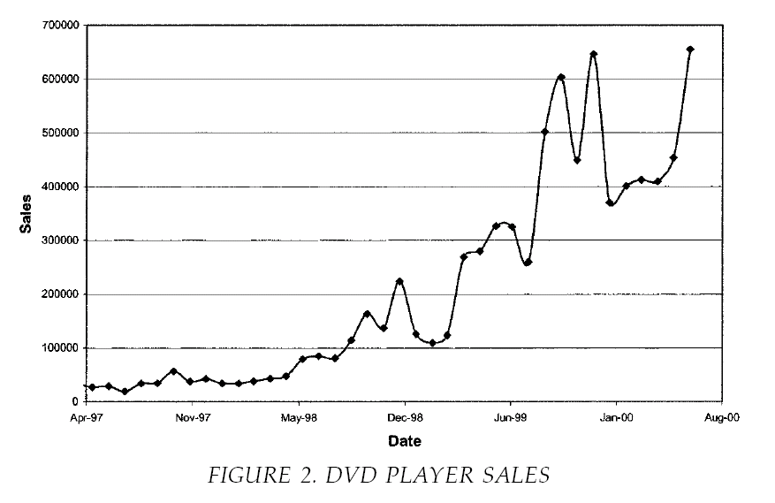
But in war (as in love) everything is possible………………..
2) The “fake” war between DVD and DIVX: the use of vaporware

Slide 4

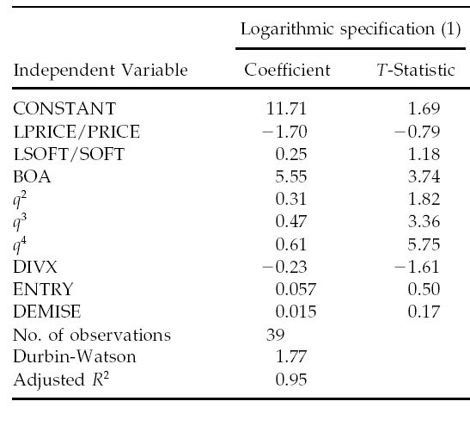
From Dranove e Gandal (2003, JEMS)

Slide 5
Question
Was the one-way compatibility strategy as pursued by Circuit City a nice move? How could have been improved?
DVD
DIVX
DIVX movies
DVD movies
From Church & Gandal (2004): “DIVX failed (..) because there was little software written exclusively for its technology”

Slide 6
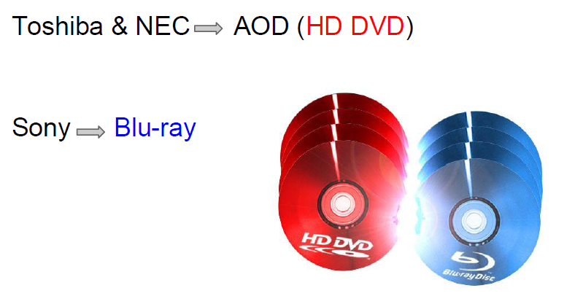
3) Sony “vendetta”: THE BLU-RAY VS. HD-DVD STANDARDS WAR

Slide 7
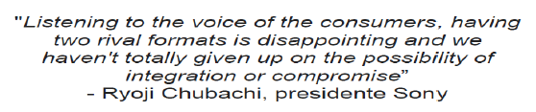

Search for an agreement
August 2005:
Failure due to the fact that the two were too different formats: too large sunk investments to lose and/or too high absorption costs to incur for the “follower”

Slide 8
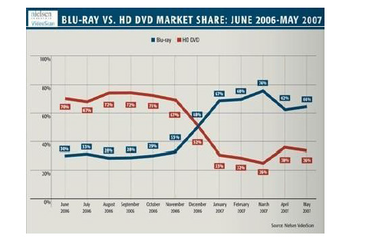
Launch and start-up phase
CES 2006: both formats are present and presented
April 2006: HD DVD commercialized at $499
July 2006: Blu-ray commercialized at $999
Fall 2006: Microsoft commercialize Xbox with HD DVD add-on at $200
Fall 2006: Sony PS3 commercialized with Blu-ray at $499

Slide 9
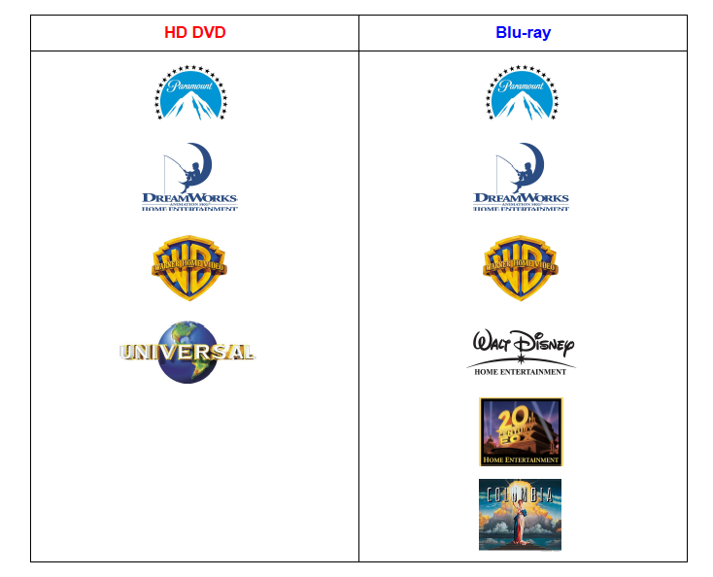
Until 2006, Sony more able to attract studios on an exclusive basis

Slide 10
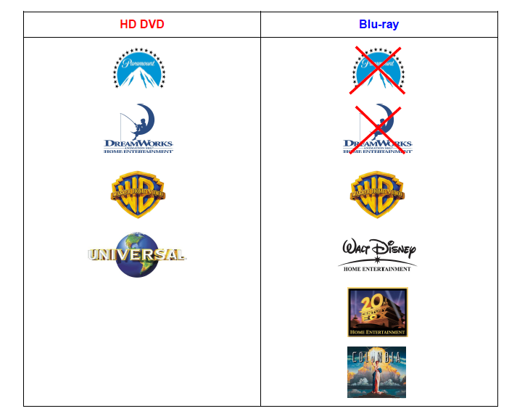
“Toshiba” countermove (September 2007)

Slide 11
Market is sluggish……..
“Despite tremendous efforts and investments by both sides to gain the upper hand, sales of both formats had been sluggish by any measure.
The slow consumer adoption was generally attributed to their reluctance to upgrade while the format war was till ongoing.
Uncertainty was also hurting the movie studios: in 2006 one analyst firm had projected that media companies stood to lose $16 billion in revenue over seven years if a single standard failed to emerge.”
[“The last DVD format war”, Andrei Hagiu, Harvard Business School]

Slide 12
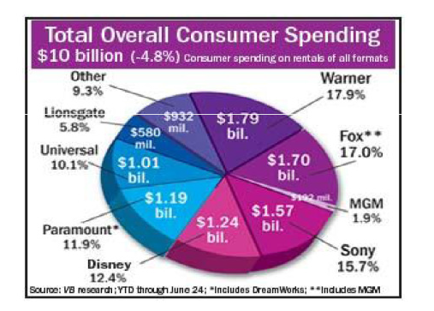
In January 2008 Warner tipped the market towards Sony

Slide 13
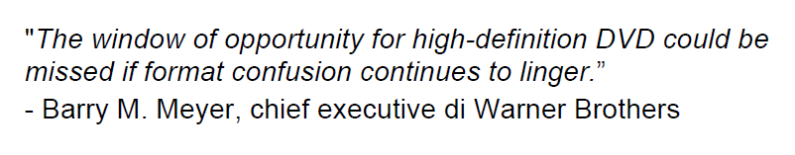
Warner’s reasons
“[They should] understand that this is the last physical format there will ever be. Everything is going to be streamed”
- Bill Gates, Microsoft chairman
U.S Sales:
Blu-ray: $169 Million
HD-DVD: $103 Million
“We’ve been monitoring the situation with consumers for a while now and they have clearly made their choice,” Mr. Meyer said. “We followed.” The New York Times, Brooks Barnes 5/1/2008

Slide 14
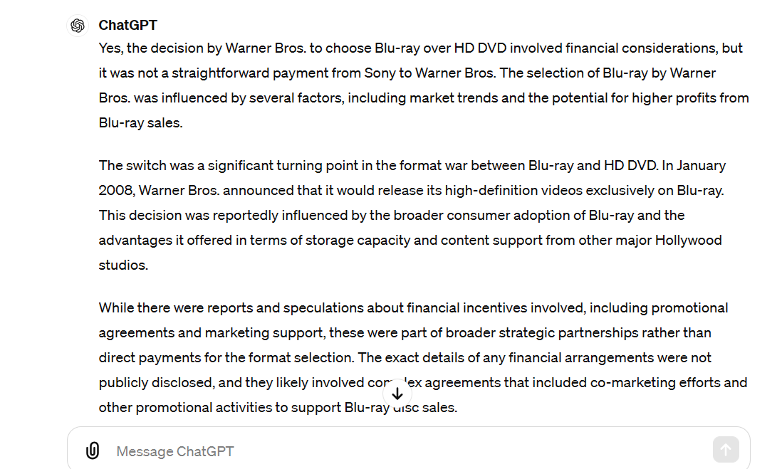
Chat GPT 4 confirms that we are in a grey area as to the role of Sony in convincing Warner
Prompt: Did Sony pay Warner for choosing Blu-Ray instead of HD DVD?

Slide 15
Toshiba’s fall
“Within a month following Time Warner’s move, electronics retailer Best Buy, movie rental company Netflix, and finally Wal-Mart, all of whom had been stocking movies in both formats, announced that they would drop HD-DVD, leading to Toshiba’s surrender.
On February 19, 2008, Toshiba announced that it would discontinue production of DVD players, recorders and parts in the HD-DVD format, which it had been championing since 2002 and in which it had invested large amounts of money to develop and bring into the market”
[“The last DVD format war”, Andrei Hagiu, Harvard Business School]

Slide 16

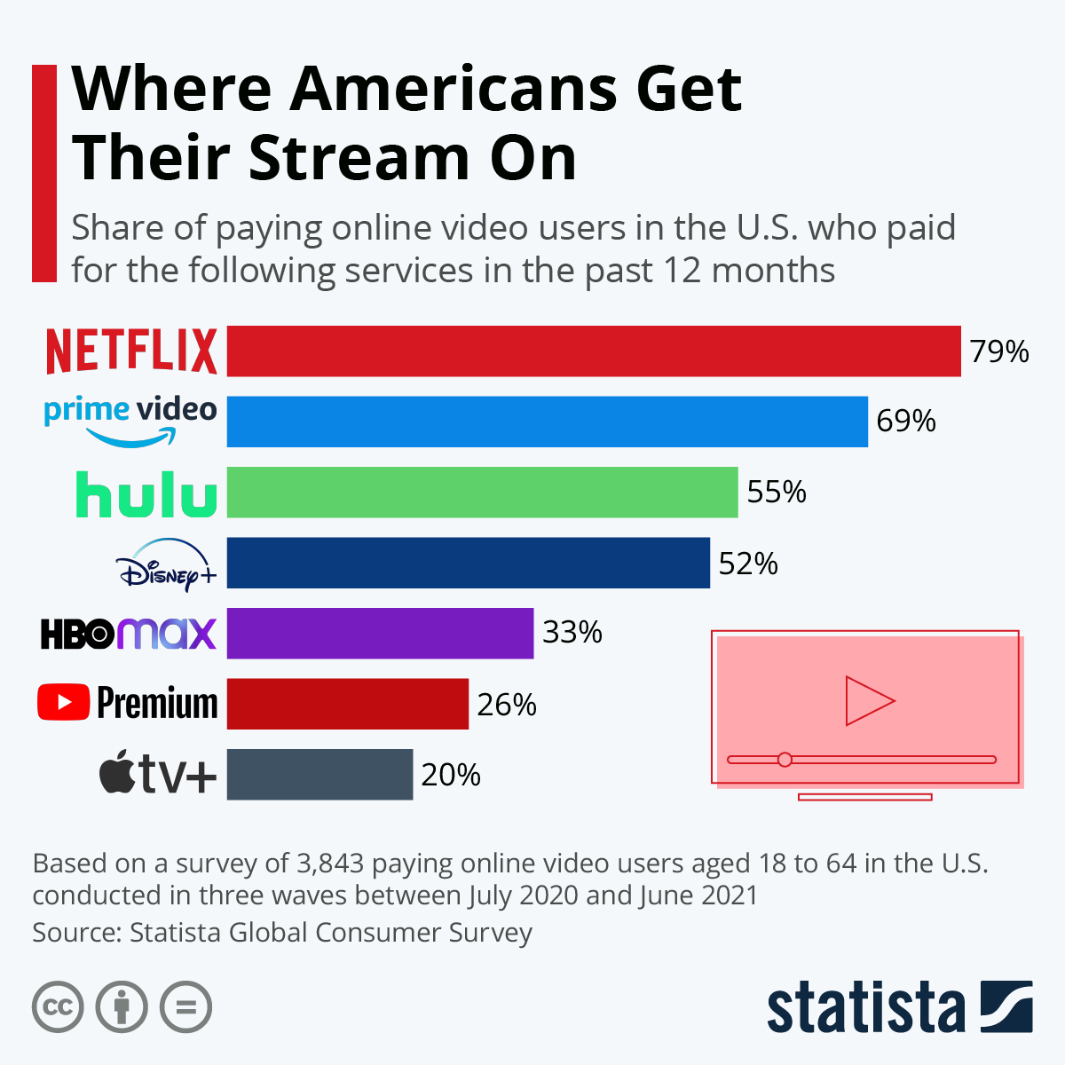
Today: Subscription video on demand

Slide 17
Switching costs & technology replacement

Slide 18
TECHNOLOGY REPLACEMENT
Which factors determine the migration of consumers from an old to a new network good?
Price
Performance
Individual Switching costs
Expectations of consumers about other consumers’ behavior (Collective switching costs)
Coordination problems and potentially strong lock-in effects

Slide 19
Technology replacement
Individual switching costs
Learning & Non-transferability of complementary assets (i.e. sunk costs given by non-fully redeployable product-specific investments)
[Search costs]
[Loyalty costs (psychological)]
Examples:
Car (low sw. costs): driving license; trailer caravan
ICT (high sw. costs): learning; compatibility
Collective switching costs
The value of the new network good will depend on how many users will switch (because of network externalities). Thus, a new chicken-egg paradox to solve (which may prove to be more difficult than a ex-novo situation, since users already satisfy to some extent their needs with the extant network good)

Slide 20
Important Note: for what concerns Hw/Sw paradigm products downward compatibility is often pursued to ease migration from old to new, but it’s now time also to highlight that this strategy may also come with some costs (and that’s why it is not “always pursued”)
Pros | Cons
Exploit switching costs (library of old software still usable by the consumers migrating towards the new hardware) | Technological “evolution” vs. “revolution”
 | New Chicken-egg paradox can be more complex to be solved Little incentive for software developers to write new software in the new format, but then consumers see that new titles are realized with the old format and so there could be no great incentive for them to migrate either towards the new hardware.
Competing Networks and Proprietary Standards: The Case of Quadraphonic Sound - Postrel 1990, JIE, 39(2), pp. 169-185, extract from pp. 177-178.
“Compatibility of quad with stereo, producing stereo sound, was considered absolutely essential by all major players. It meant that four-channel receivers could be sold without the existence of a large quad software library. But the ability of quad receivers to play stereo records cut two ways. By failing to render existing consumer investments obsolete, stereo compatibility encouraged consumers to stick with two-channel hardware and software. Furthermore, software producers' incentives [to launch in the market quad records] were weakened because stereo records could be sold to the quad user base.”

Slide 21
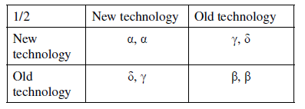
Technology replacement (The adoption game, Farrell and Saloner, 1985, Rand Journal of Economics)
2 users should decide if they want to shift from the old good to the new one
The payoff of each user depends on the decision of the other user because of network externalities
Network externalities:
𝛼>𝛿,𝛾
𝛽>𝛿,𝛾
Nash equilibria: (new, new); (old; old)
𝛽<𝛼 and (old, old) is the market equilibrium → EXCESS INERTIA (strong)
𝛽>𝛼 and (new, new) is the market equilibrium → EXCESS MOMENTUM (strong)

Slide 22
Things might be even more blurred… (Cabral, 2010 and 2018)
1/2 | N | O
N | b1-c1; b2-c2 | -c1; 0
O | 0; -c2 | a1; a2
If (b1-c1) = (b2-c2) > 0 [same analysis as before, 2 NE, potential Excess inertia, or Excess momentum, depending on actual values]
But (b1-c1) ≠ (b2-c2). Suppose (b1-c1) > a1 and (b2-c2) < a2. For example b1 = 5, b2 = 3, c1= c2 = 2, a1 = a2 = 2.5
1/2 | N | O
N | 3; 1 | -2; 0
O | 0; -2 | 2.5; 2.5
2 NE as before (N;N) and (O;O) but now none Pareto dominates the other
Excess (M or I) is limited to segments of population

Slide 23
The Only Subgame perfect Nash Eq.
N
b1-c1; b2-c2
3;1
N
2
O
-c1; 0
-2;0
1
N
0; -c2
0;-2
2
O
O
a1; a2
2.5;2.5
b1-c1 (slightly) > a1; b2-c2 (slightly) > 0 and < a2
N; N
But (b1-c1) + (b2-c2) < a1+a2 [the gain of “1” type does not compensate for the loss of “2” type in changing]

Slide 24
Technology replacement (excess inertia example)
(Cabral, 2010 and 2018)
But we are only talking about inertia (as we know, at the end, in the long-run, the best technology is likely to prevail).

Slide 25
Technology replacement (excess momentum example)
(Cabral, 2018)
“Software updates are sometimes an example of excess momentum (the term forced upgrades is also used in this context). Many users of Office 95 were quite satisfied with their version of the software. However, when a number of key players adopted Office 97, owners of Office 95 had an incentive to switch to Office 97 for reasons of compatibility.
This does not mean that, in the end, these users were made better off. They would probably prefer the initial situation when every user worked with Office 95. However, the new situation (everyone with Office 97) is better than sticking to Office 95 while the rest of the world switches to Office 97. Switching to Office 97 is then the lesser evil, as it were.”
(p. 409)

Slide 26
REFERENCES
(for case studies)
DVD: Dranove, D., & Gandal, N. (2003). The DVD‐vs.‐DIVX standard war: Empirical evidence of network effects and preannouncement effects. Journal of Economics & Management Strategy, 12(3), 363-386.
Blu Ray: Hagiu, A. (2010). The Last DVD Format War? HBS Case, (710-443).

Slide 27
ESSENTIAL REFERENCES
(for all lectures on network economics)
L. Cabral, Introduction to Industrial organization, I edition, 2000, Chapter 16.
J. H. Rohlfs, 2001, Bandwagon effects in high-technology industries, MIT, Boston, Chapters 3,4,5.
Additional:
C. Shapiro e H. R. Varian, 1999, Information rules, ETAS Libri
Peter Grindley, 1995, Standards, Strategy, and Policy,Cases and Stories, Oxford University Press.
L. Cabral, Introduction to Industrial organization, II edition, 2018, Chapter 16.

